Slide 1
Digitalization of Business Processes
Supplier Selection Group Project
Lukas Uske, Talip Ates, Alexis Marquet, Joanne Chimuti-Lobsiger, Harpreet Kaur
28.05.2026
DigiBP Group Project

Slide 2
About The Project
Source-to-Order process automation
Automated supplier selection (DMN-driven)
Digital self-service Request form
Eco-friendly Product request
Addressing Manual bottelnecks & Slow response
Powered by Camunda 7 & Make.com
Product not available in catalog
Office Supplies E-commerce Case study
DigiBP Group Project

Slide 3
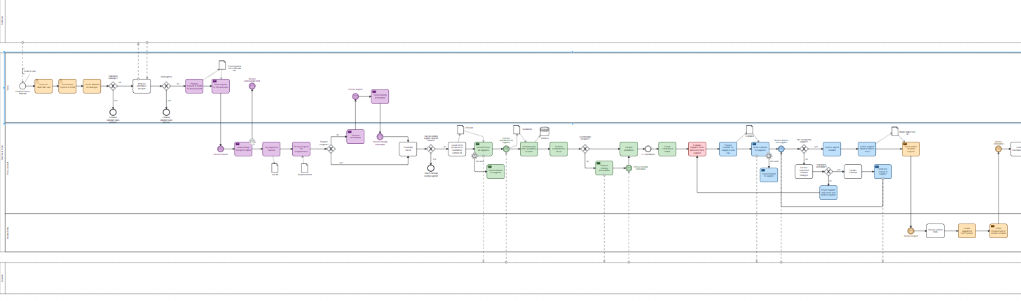
As-is Process
Manual entry by a phone or email.
Sales manually logs the request and uses email-based notification to reach procurement.
Procurement manages sourcing and supplier quotation.
Excel based supplier comparison and manual supplier creation in ERP by master data.
Contracts are stored in shared folders and the process closes with manual order confirmation.
DigiBP Group Project

Slide 4
Challenges in the As-is Process
Intuition based selection without weighted score
Disconneted systems (CRM List, Excel, Email)
Error-prone Excel file lack traceability
Risk of lost request and missing data
Manual notification cause coordination bottelnecks
No real-time tracking or central repository
DigiBP Group Project

Slide 5
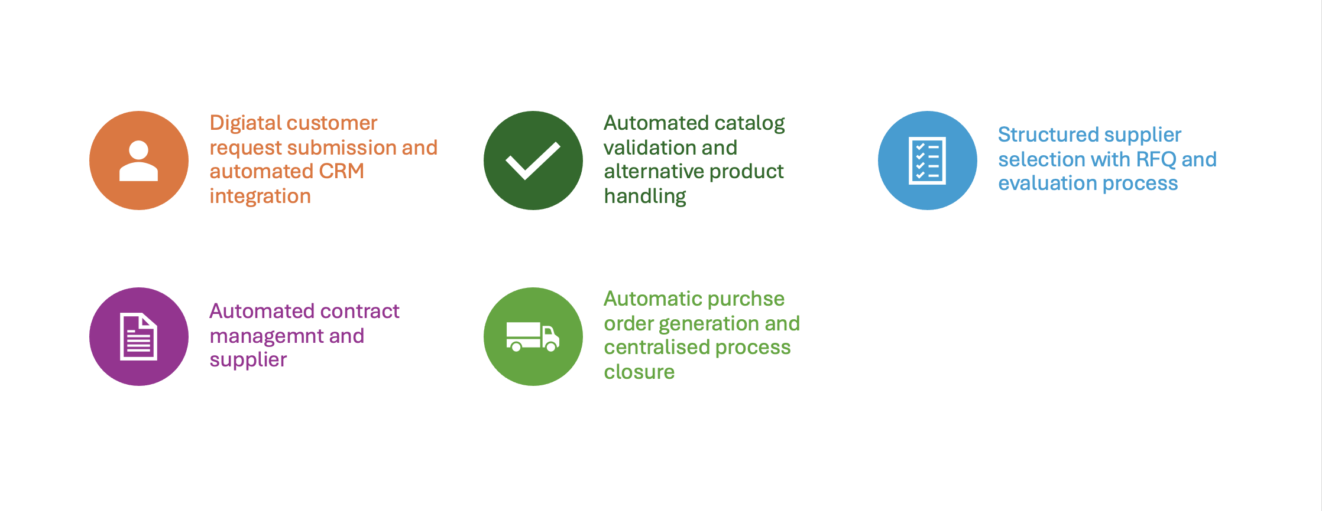

About our To-be-Process
Opportunities for further development towards automated purchase order and tracking
Digital self-service google form with automated process start via Make.com integration
Automated supplier scoring and selection using DMN decision tables
Standardized data capture and clear digital process with workflow engine
Automated contract draft generation via Make.com and Google Docs​
Overview of every customer request, enables further analysis
DigiBP Group Project

Slide 6
To-be-Process
Google Form
Camunda
Supplier RFQ
DMN Evaluation
Make.com
Contract draft
DigiBP Group Project

Slide 7
Gains of the To-be-Process
Reduced cycle Times Digital “self-service” form replaces manual phone/email triggers.
Objective & Auditable Decisions Consistent supplier scoring using DMN decision table.
Seamless Tool IntegratioN Camunda and Make.com bridges the gap between fragmented systems.
Complete Audit trail Every decision, score, and form submission is digitally logged.
Full Process Visibility Possible to Track requests via Camunda Cockpit.
DigiBP Group Project

Slide 8
Questions
DigiBP Group Project
DigiBP Group Project

Slide 9

Thank you
DigiBP Group Project

